Slide 1
Technical Resolution
Ankit Garg

Slide 2
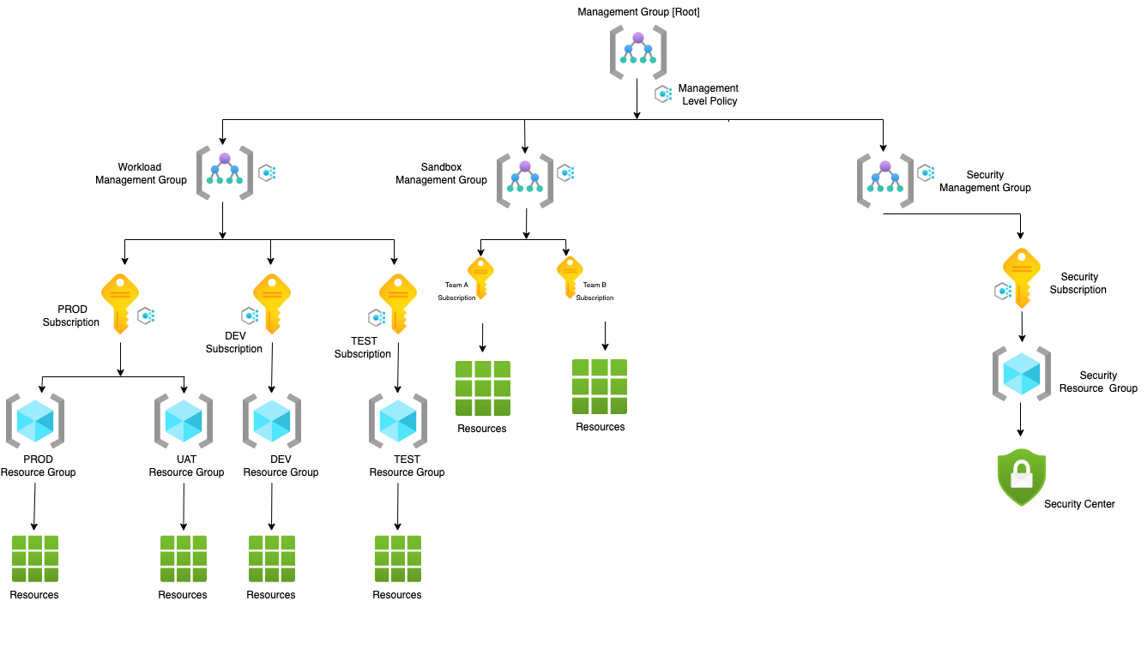
Technical Challenges
Challenge #1
A 3-tier environment is a common setup. Use a tool of your choosing/familiarity create these resources on a cloud environment (Azure/AWS/GCP). Please remember we will not be judged on the outcome but more focusing on the approach, style and reproducibility.
Solution #1
From Compliance and Governance Prospective, resources will be managed with Management Group and Subscription (Azure landing Zone):-

Slide 3
Technical Challenges
Azure Policy will be Applied to Management Group or Subscription or Resource Group and will follow the inheritance.
RBAC will be applied to Management Group or Subscription or Resource Group and will follow the inheritance.
Created 3-Tier Environment Setup using Terraform Script for Resource Creation.
One virtual network tied in three subnets.
Each subnet will have one virtual machine.
First virtual machine -> allow inbound traffic from internet only.
Second virtual machine -> entertain traffic from first virtual machine only and can reply the same virtual machine again.
App can connect to database and database can connect to app but database cannot connect to web.
For Outbound Access from WEB,APP or DB tier, We can use Azure NAT Gateway in another subnet (/28 public IP prefix).
We can increase the instance and put in diff AZ and Load Balancers can be used to cater the traffic.
We can create diff workspace for the IAC script and put the state file in Azure Storage.
Create YAML file to deploy the Terraform Script in the Env.
Certainly, we can enhance the script as we move on.
Github Location(https://github.com/gxa3366/ThreeTierIAC)

Slide 4
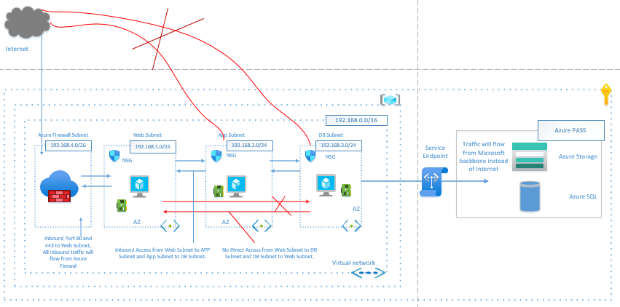
Technical Challenges

Slide 5
Challenge #2
We need to write code that will query the meta data of an instance within AWS or Azure or GCP and provide a json formatted output. The choice of language and implementation is up to you.
Solution #2
Option #1
Develop the Console application using Microsoft .NET Core template.
Azure resources like Azure VM are created.
Register an application “Myappinstancemetadata” in Azure AD (App registration and fetched few details:-
Client ID, Client Secret, Tenant ID
Grant Reader Role assignment of Registered App to Azure VM.
Created Azure Key Vault and store all the secret keys (Client ID etc..) into Key Vault.
In code, We are using Azure Identity Package and getting all the key Values at run time.
KeyVaultSecret secret;
var client = new SecretClient(new Uri("https://myappkeyvault02.vault.azure.net"), new DefaultAzureCredential());
secret= client.GetSecret("secretName");
string secrets = secret.Value;
We are calling Management Azure Rest API to get the details of Instance (https://management.azure.com/)
Github URL (https://github.com/gxa3366/VmMetadataAPI)

Slide 6
Option #2
Develop the Console application using Microsoft .NET Core template.
Deploy the code into Azure App Service or Function App or VM ( which support Managed Identity )
System Defined Managed Identity should be enabled.
For Authorization to Azure Key Vault, App Principal will be added and give permission to get and list key vault secret.
Key Vault reference in App Setting will be implemented to fetch keys from Key vault at runtime(@Microsoft.KeyVault(SecretUri=https://myvault.vault.azure.net/secrets/mysecret/)
Use Azure Identity Package ( var identity = new DefaultAzureCredential()), to run the code in App Service / local without any code change.

Slide 7
Challenge #3
We have a nested object. We would like a function where you pass in the object and a key and get back the value. The choice of language and implementation is up to you. Example Inputs
object = {“a”:{“b”:{“c”:”d”}}}
key = a/b/c, value = d
object = {“x”:{“y”:{“z”:”a”}}}
key = x/y/z, value = a
Solution #3
Develop the Console application using Microsoft .NET Core template.
Created two projects
NestedObjects :- Created Nested Method to get the value by Key.
NestedUnitTestCase :- Created Test Case to test the Nested Object functionality.
Github URL (https://github.com/gxa3366/NestedObjects)

